Slide 1

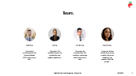
© 2023 Strawberry Inc. All rights reserved (because we're berry serious about it). The information and technologies described within are subject to change.
Digitalization of Business Processes SS 2023 | FHNW
Notes:
Karolina

Slide 2
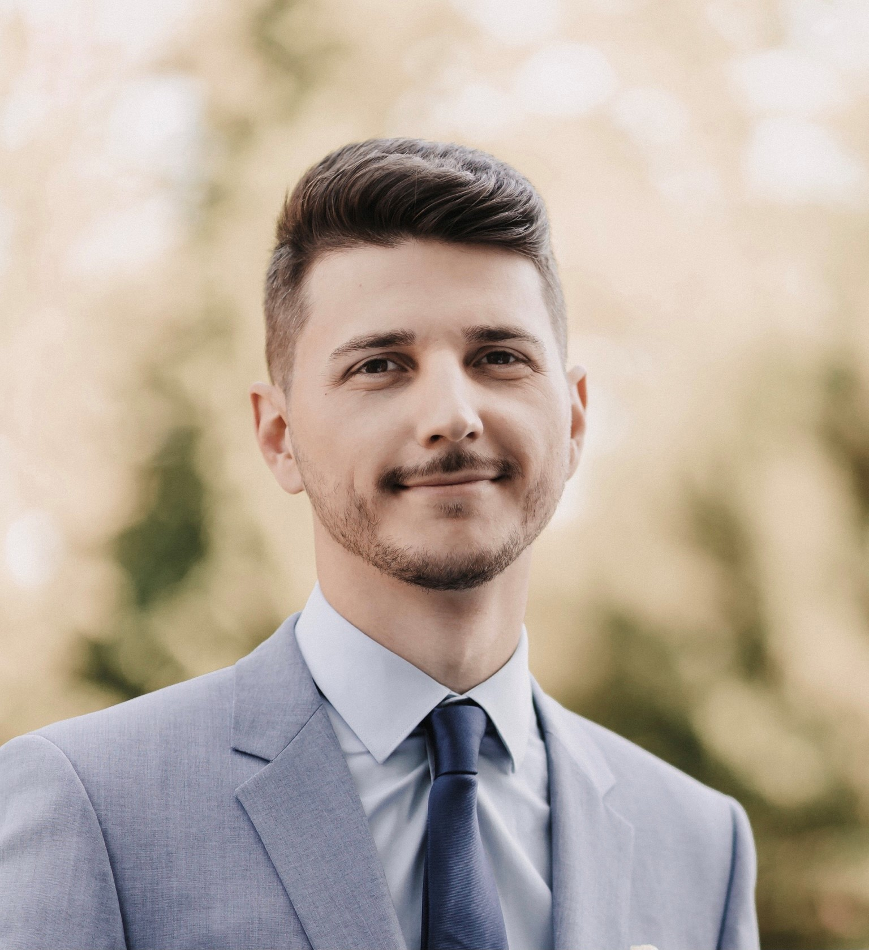
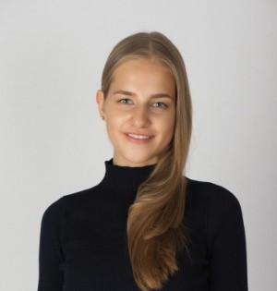
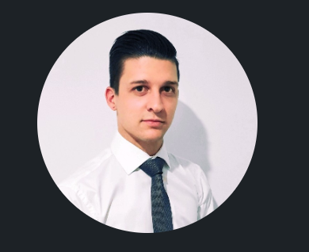
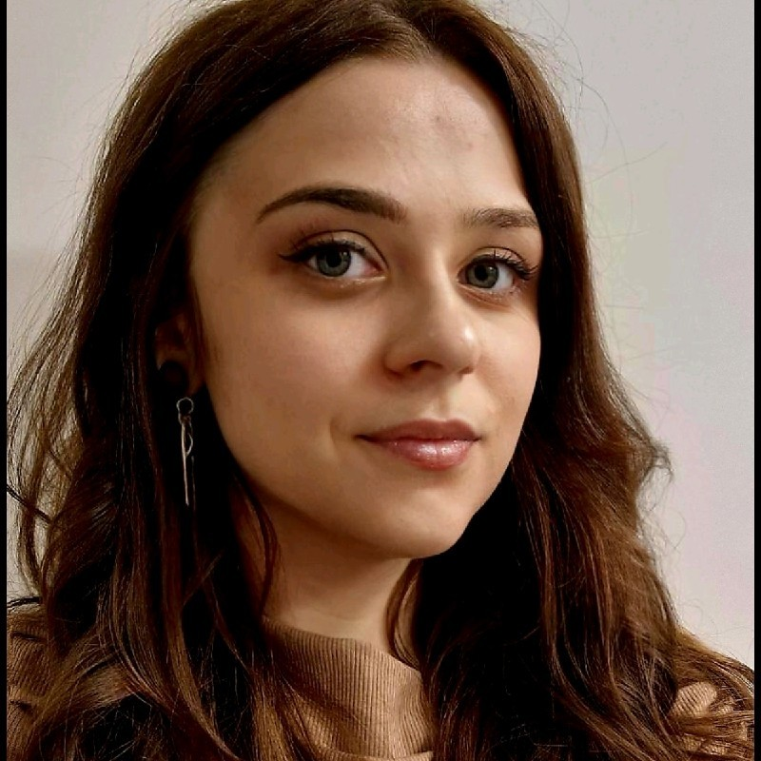
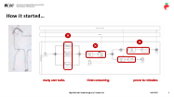
Team.
Addhe
"Camunda is my therapist for the Process-Related PTSD I never knew I had."
Alise “Camunda: The unofficial sponsor of productivity and caffeine addictions.”
Andrew
"Camunda, the surprise fix for the workflow nightmares I didn't even know I had!"
Karolina
"Camunda: Where workflows go to get a reality check and students go to question their life choices."
Notes:
Karolina
Intro to the company
Intro team
Intro case – supplier selection

Slide 3
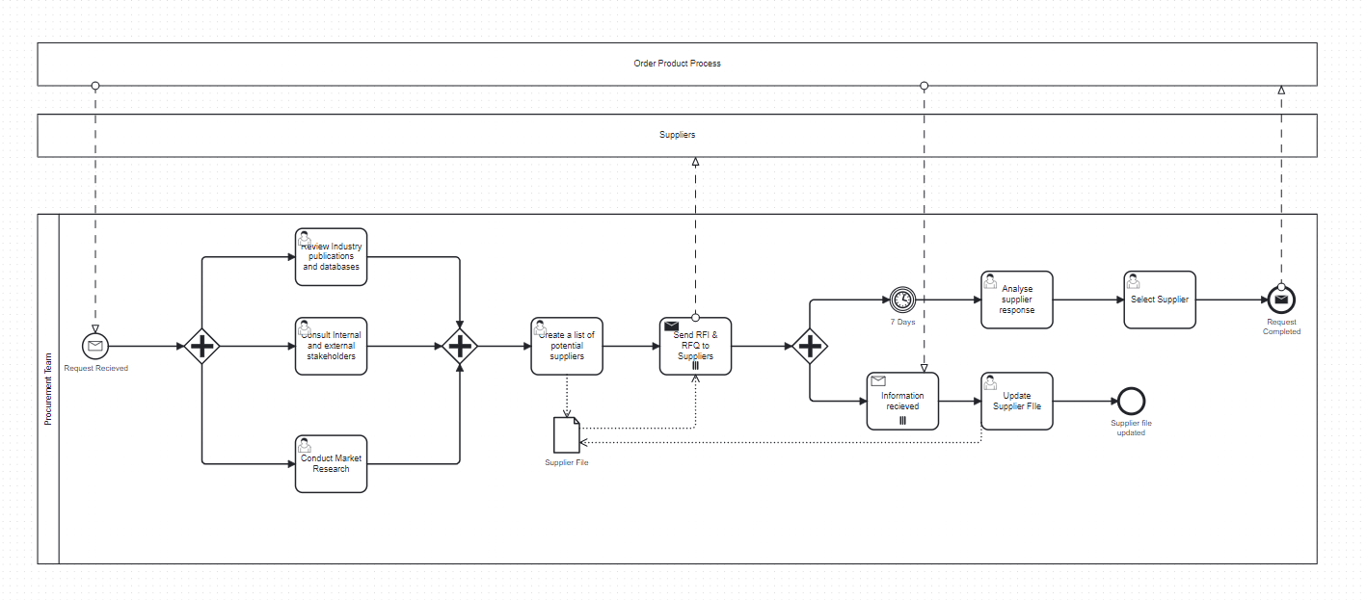
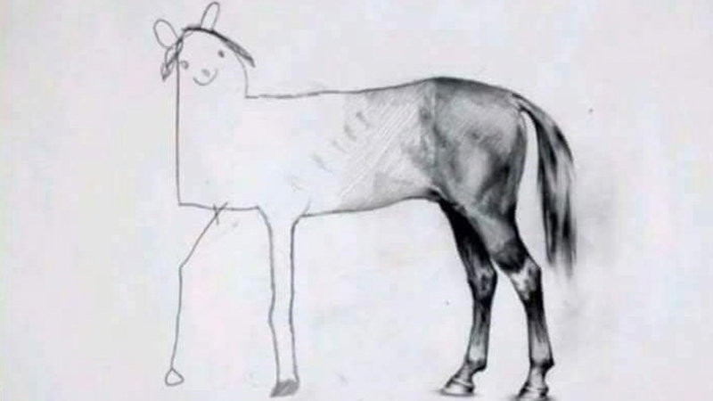

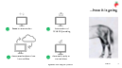
How it started…
many user tasks.
time-consuming.
prone to mistakes.
Notes:
Andrew

Slide 4






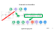
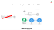
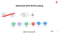
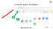
…how it is going
Research automation
Automation of RFI & RFQ sending
Automated update of the internal files
Automatic reply to the recipient
Notes:
Andrew
What did we use to automize/digitlize the service tasks – MAKE (LCAP)

Slide 5
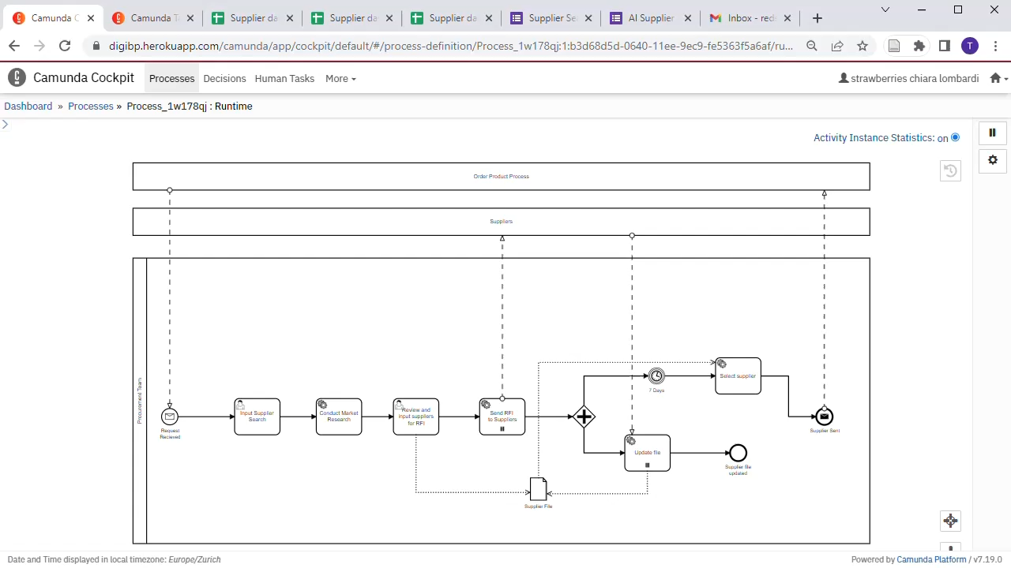
Demonstration
Notes:
https://youtu.be/xOC39kIblyI Andrew

Slide 6
…how it is going
Research automation
Automation of RFI & RFQ sending
Automated update of the internal files
Automatic reply to the recipient
Notes:
Andrew
What did we use to automize/digitlize the service tasks – MAKE (LCAP)

Slide 7
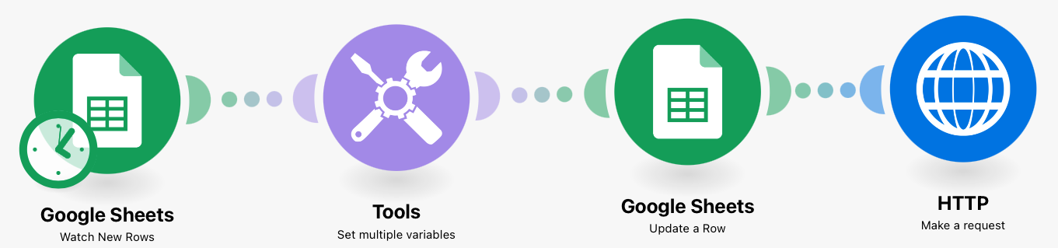
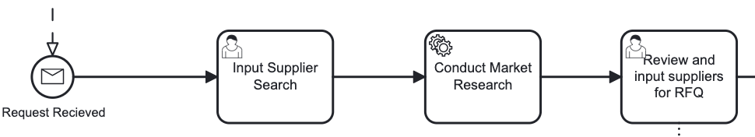
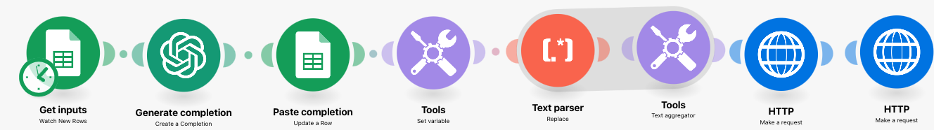
Research automation
Notes:
Andrew

Slide 8
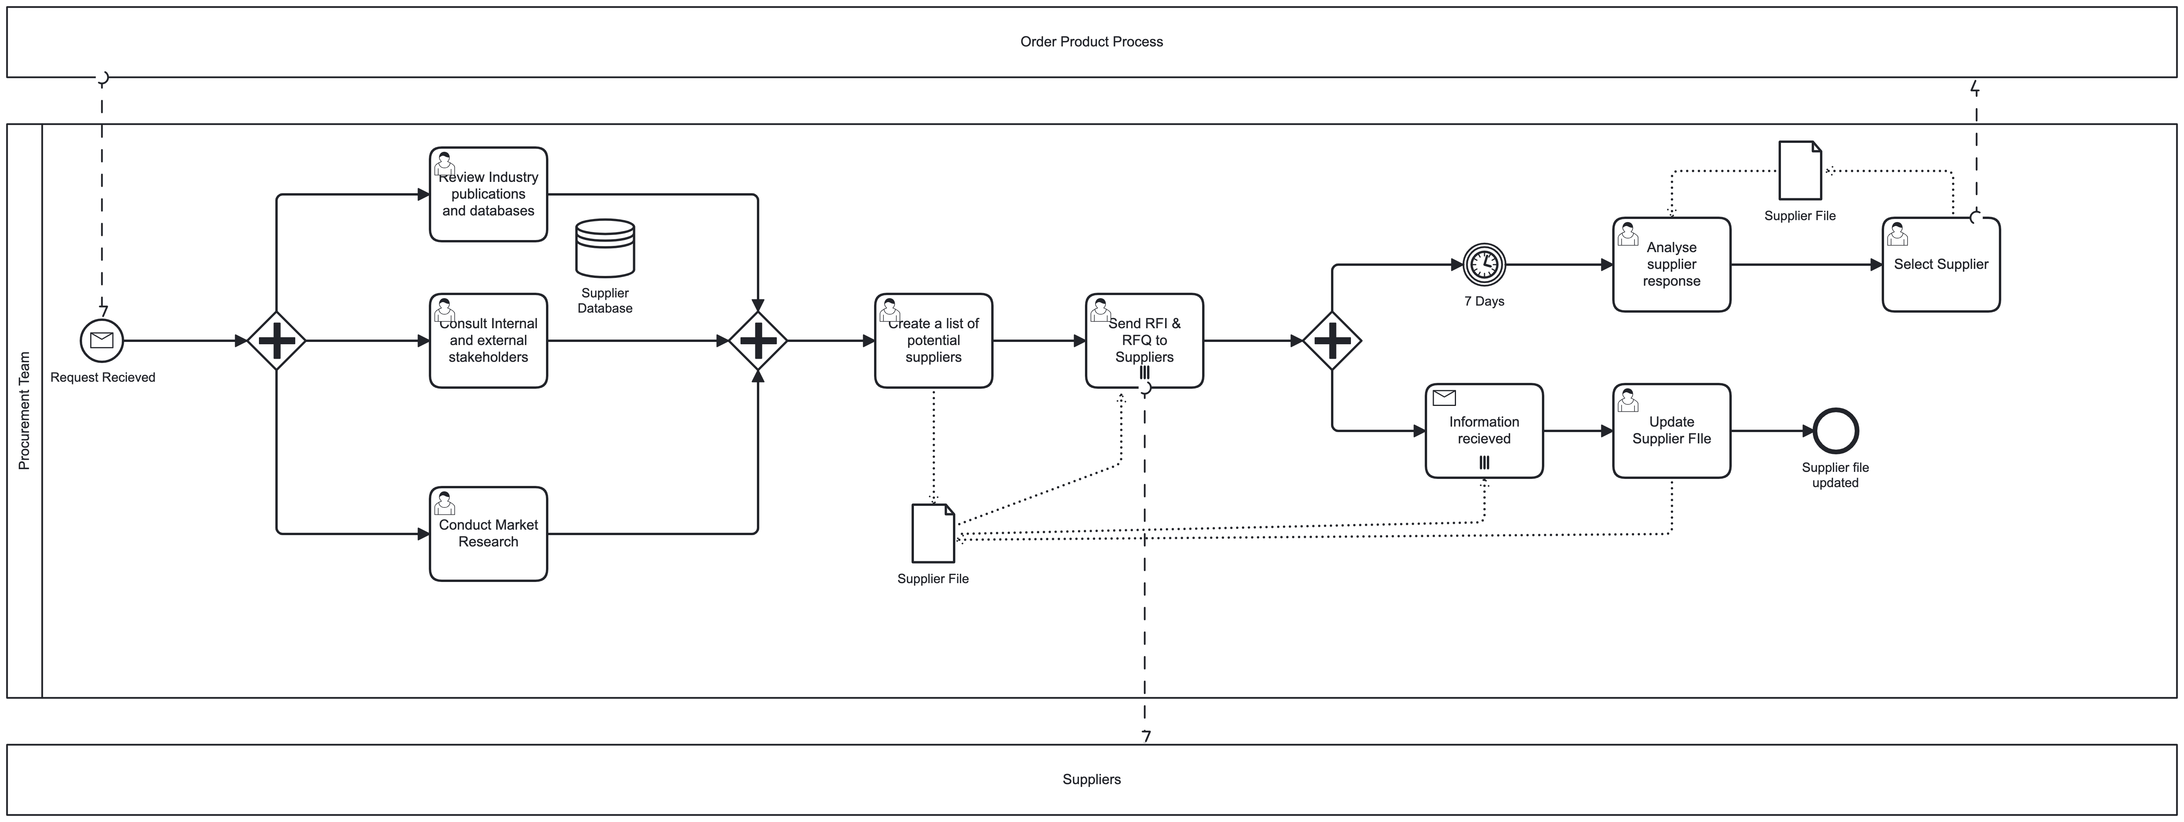
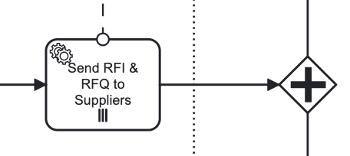
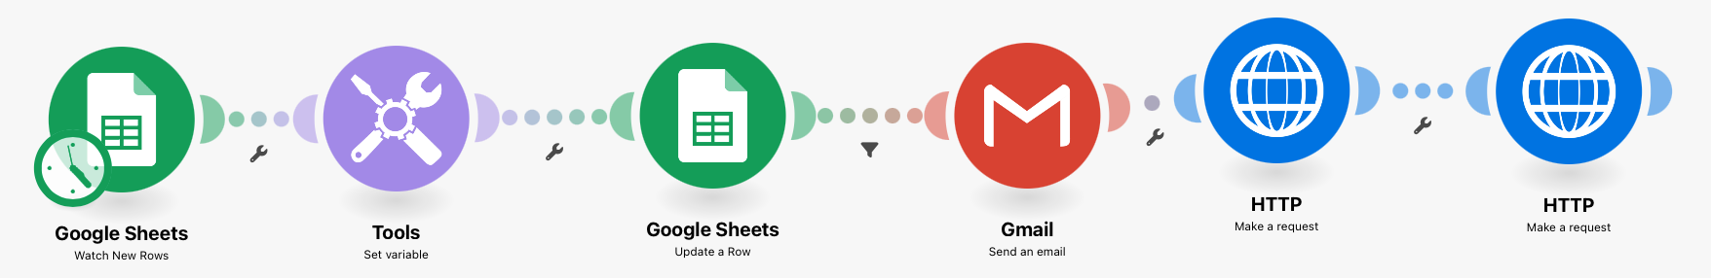
Automation of RFI & RFQ sending
Notes:
Alise

Slide 9
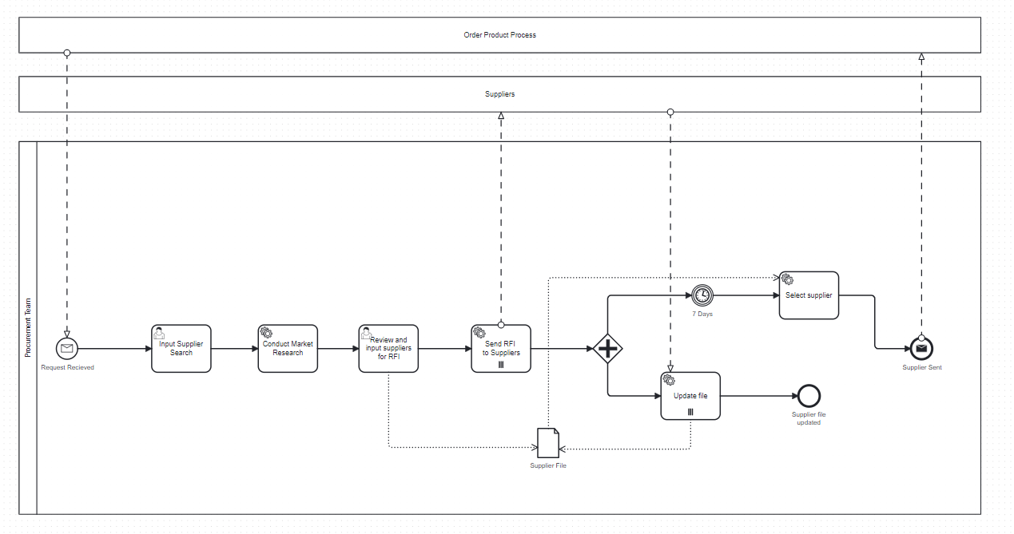
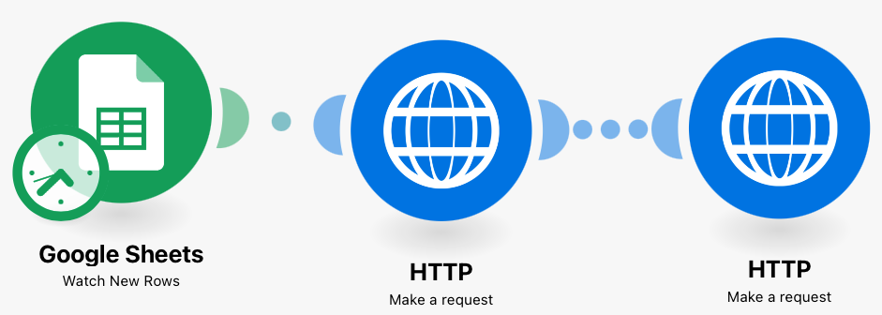
Automated update of the internal files
Notes:
Alise

Slide 10
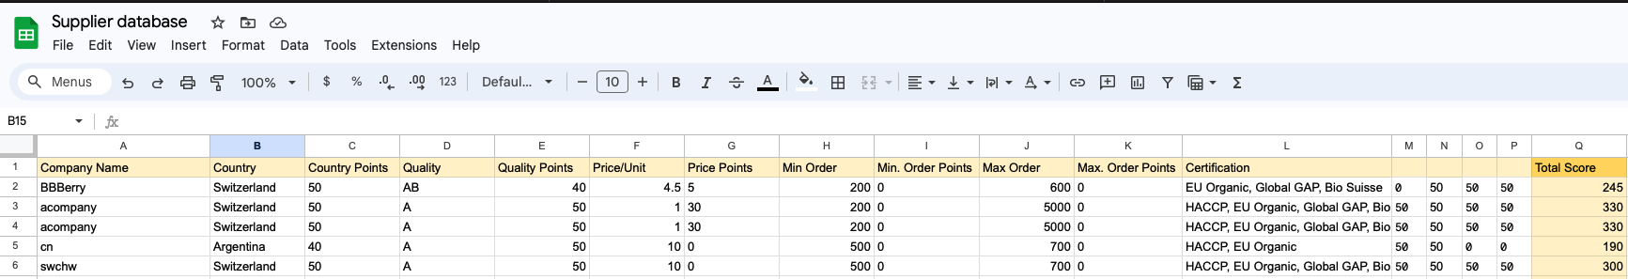
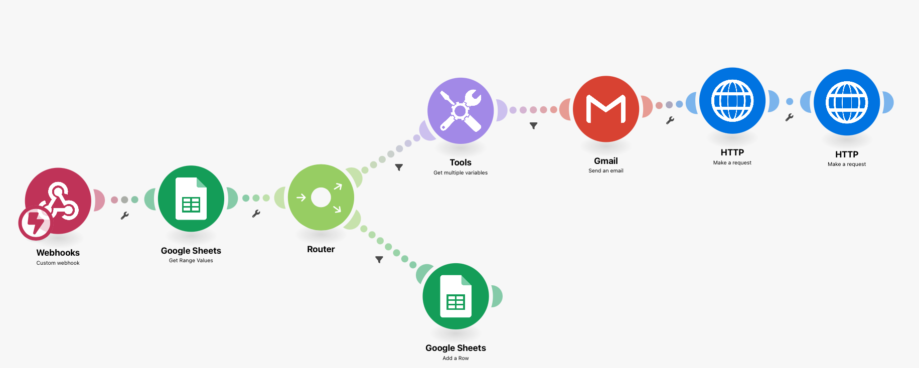
Automatic reply to the recipient
Notes:
Addhe

Slide 11
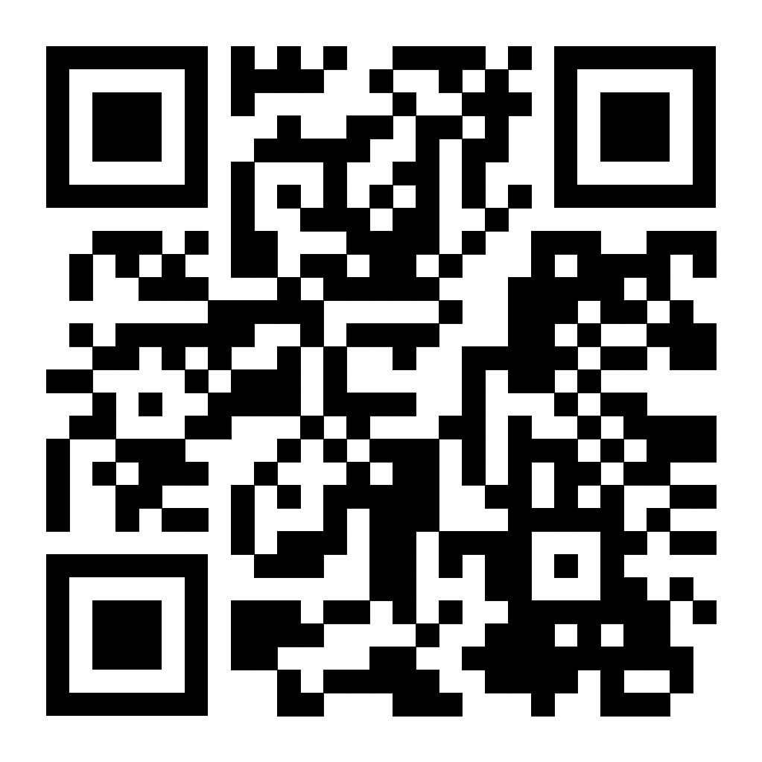
Thank you.
…check our GitHub site.
Notes:
Andrew

